Slide 1
Requirement Evolution
By: Fariha Shaikh

Slide 2
Concept Of Evolution:
Evolution means: the gradual development of something.
Evolution of requirements refers to changes that take place in a set of requirements after initial requirements engineering phase. Thus changes in requirements that may happen in initial elicitation, analysis, specification and validation phases are not evolutionary.
Changes in requirements are additions, omissions or modifications of requirements [Sta 1999].

Slide 3
The evolution of requirements refers specifically to the changes that occur in the requirements after the initial requirements engineering phase has been completed. In this context, it excludes changes that happen during the early stages of the project, such as:
Elicitation: Gathering initial requirements from stakeholders. This is the phase where requirements are first identified, and changes here are expected as stakeholders clarify their needs and priorities.
Analysis: Understanding and refining requirements for feasibility, clarity, and alignment with business objectives. During analysis, adjustments are made to ensure requirements are realistic and clear, but these are not yet considered evolutionary changes.

Slide 4
3) Specification: Documenting requirements in detail. Adjustments made to ensure accuracy and completeness in this phase also do not count as evolutionary, as they are part of the initial development of the requirements.
4) Validation: Checking that requirements are correct, complete, and aligned with stakeholder expectations. Changes due to validation feedback help finalize the requirements, but they are still part of the initial phase.
In other words, requirement evolution occurs after the initial requirements engineering phase is completed and the project has moved into the development or operational phase. Evolutionary changes are typically driven by external factors—like changing business goals, user feedback, technological advancements, or unforeseen issues in implementation—rather than the initial clarification and refinement activities in requirements engineering.

Slide 5
What is Software Evolution?
The software evolution process involves key steps: analyzing what changes are needed, planning when to make those changes, updating the system, and then delivering the updated version to customers. 1) Evaluate the cost and impact of proposed changes to see how they affect the system and their implementation cost. 2) If changes are approved, create a plan for the next software release.
3) Review all suggested updates (including fixes, adjustments, and new features) to decide which to include.
4) Implement the changes by designing, building, and testing them in a development cycle.

Slide 6
Necessity of Software Evolution
Software evaluation is necessary just because of the following reasons:
Adapt to Changing Requirements/Change in requirement with time: As user needs, business goals, and market demands evolve, software must be updated to stay relevant and useful.
Environment Change: when the working conditions evolve, organizations may need to update old software with new features and functions to fit the new environment. ( Improve Performance and Efficiency)
Errors and Bugs: Over time, older software can become less accurate and less efficient at handling the growing complexity of tasks. As a result, it’s important to avoid using outdated software. To keep up with today’s demands, old software needs to be updated and improved to handle current workloads effectively.

Slide 7
4) Security Risks: Using outdated software can put an organization at risk of cyber attacks, which may compromise sensitive data. To prevent these security breaches, it's essential to regularly check that the software is using the latest security updates and patches. If the software cannot effectively protect against current cyber threats, it should be updated or replaced.
5) For New Functionality and Features: To improve performance and enable faster data processing, organizations need to continually update their software throughout its lifecycle. This evolution ensures that stakeholders and clients can work efficiently with the product.

Slide 8
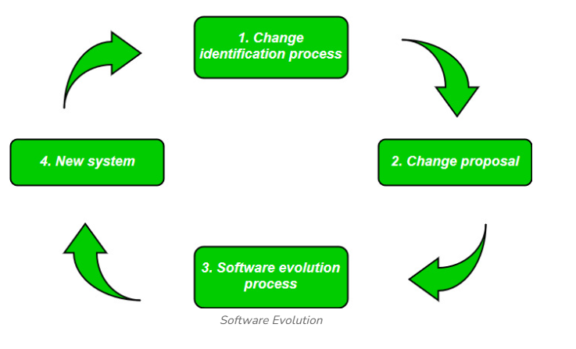

Slide 9
Laws Apply On Requirement Evolution:
There are several key laws and principles that apply to requirement evolution in software development, particularly relevant to the adaptation and growth of requirements as systems evolve:
Software engineering researcher Meir Lehman identified a set of laws for software evolution, many of which apply directly to requirement evolution:
Law of Continuing Change: Software must be continually updated to adapt(make something suitable for a new use) to a changing environment, or it will become less useful over time. This law emphasizes the need for evolving requirements to keep software relevant.

Slide 10
2) Law of Increasing Complexity: As software evolves, its complexity typically increases unless work is done to manage and reduce it. This means that as requirements evolve, careful design and management are needed to prevent the system from becoming overly complex.
3) Law of Self-Regulation: The Law of Self-Regulation means that as software develops and requirements change, the process becomes steadier and easier to predict. This suggests that the team can manage changes in requirements better as they become more familiar with the software.

